Slide 1
SQL Triggers, Functions & Stored Procedures
Programming Operations

Slide 2
Objectives
Understand Triggers and their usefulness
Understand Functions
Understand Stored Procedures

Slide 3
SQL Server Administrator’s Duties
Install and configure SQL Server
Plan and create databases
Back up the databases
Restore the databases when necessary
Set up and manage users for SQL Server
Manage security for new users and existing users
Import and export data
Set up and manage tasks, alerts, and operators
Manage the replication environment
Tune the SQL Server system for the optimal performance
Troubleshoot any SQL Server problems

Slide 4
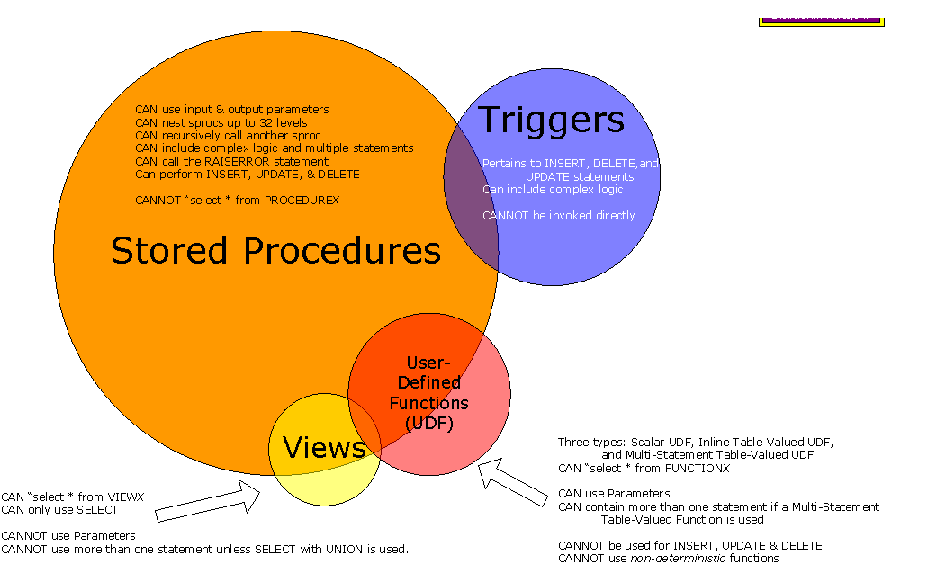
Introduction to Triggers and Stored Procedures

Slide 5
Introduction to Triggers and Stored Procedures
Stored Procedures and Triggers within a database are similar constructs. They can both perform the same SQL statements. The biggest difference between the two is how they are executed. A stored procedure has to be executed by a user, while a trigger is executed by the system as the result of an event. Events that cause triggers to be activated include data inserts, updates and deletes. One drawback to using triggers instead of stored procedures is that they cannot accept parameters.

Slide 6
SQL Triggers
Triggers in SQL Server 2012 are a special kind of stored procedure that fires automatically; they are invoked or executed when an event occurs in the database server. We can create Data Manipulation Language (DML) triggers and Data Definition Language (DDL) triggers in SQL Server 2012.
When the user wants to modify data using a DML event then the DML trigger is executed. In other words, a DML trigger is used for INSERT, DELETE and UPDATE statements of a table or view.
When the user attempts to perform an operation using DDL then the DDL trigger is executed. In other words, a DDL trigger is executed for CREATE, ALTER and DROP statements of a table or view.

Slide 7
SQL Triggers
Why use Triggers?
There are several reasons to use triggers. Some of them listed below:
Log database activity
Implement Business Rule
Enforce referential integrity. Example: When you delete a customer, you can use a trigger to delete corresponding rows in the orders table.
Triggers can access both old and changed values on insert, delete, update operations.

Slide 8
SQL Triggers
Data manipulation is necessary with many operations in SQL server. Several database objects require manipulation of data. The trigger allows user to implement the data manipulation. A trigger is a set of SQL statements that are activated in response to certain actions.
The data integrity is ensured with triggers in SQL server for data manipulation. A trigger is a stored procedure for executing in response to certain events.
Types of Triggers
In SQL Server, there are several types data manipulation operations. The following trigger types are used in SQL Server.
1) Data Manipulation Language ( DML )
2) Data Definition Language ( DDL )
3) CLR Triggers
4) Logon Triggers

Slide 9
SQL Triggers
A DML trigger is used when the tables are affected by the DML statements, as INSERT, UPDATE and DELETE. They help user in maintaining the consistent, reliable, and proper data in the tables.
The characteristics of the DML trigger are as shown below:
1) They do not return any data to the user
2) The incorrect, inconsistent and unauthorized changes are restricted by the user
3) They cannot be explicitly invoked or executed
4) They are fired automatically when the data modifications statement is executed
5) The nesting up to 32 levels is allowed in the triggers
User fires a trigger in response to the INSERT, DELETE and UPDATE statements. Two temporary tables are created which are known as magic tables. They are known as inserted or deleted. The structure of these tables is similar to the database tables.

Slide 10
SQL Triggers
INSERT trigger - The trigger is fired when the attempt is made to insert a row in the trigger table. After the INSERT statement is executed the new row is added to the Inserted table.
DELETE trigger - It is fired when the attempt is made to delete the row from the trigger table. The deleted rows are added to the Deleted table. There are no common rows between deleted and database table.
The DELETE trigger is implemented in three ways as mentioned below:
a) The cascade method: It is used to delete the corresponding records from the dependent table when the record is deleted from the master table
b) The restrict method: It restricts the deletion of records from the master table if the related records are present in the dependent table.
c) The nullify method: It is used to nullify the values in the specified columns of the dependent tables whenever a record is deleted from the master table.
UPDATE trigger - It is fired when the UPDATE statement is executed in the trigger table. Two logical tables are used for the operations performed by the trigger. The Deleted table contains the original rows and the Inserted table contains the new rows.

Slide 11
SQL Triggers
There are three types of triggers in SQL Server 2012:
AFTER Trigger - executes after DML SQL statements
INSTEAD OF Trigger - this executes instead of actual DML statement
FOR Trigger

Slide 12
SQL Triggers
The DDL triggers are fired in response to the DDL statements as CREATE TABLE and ALTER TABLE. The task as database auditing is performed by the DDL trigger. DDL operations can contain creation of table or view, modification of a table or procedure.
Nested Triggers - Nested triggers are fired due to the actions of other triggers. DML and DDL triggers can be nested while performing an action of initiating another trigger. Consider an example of DELETE trigger on the Department table deleted the corresponding records of employee table and the DELETE trigger on the Employee table inserts those deleted employee records in the EmpHistory table.
Recursive Triggers - Recursive triggers are special type of nested triggers. The recursive trigger can call itself. The types of recursive trigger are as follows:
a) Direct
b) Indirect

Slide 13
SQL Triggers
Direct recursive trigger - When a trigger is fired and actions are performed causing the same trigger to fire again. The trigger is known as direct recursive trigger.
An indirect recursive trigger fires a trigger on another table and the nested trigger ends up firing the first trigger again. Consider an example, table A fires a trigger, it fires an update on table B. The table B fires another trigger on table C. Table C causes another trigger on table A again. The update trigger is fired on table A again.

Slide 14
SQL Triggers
The CREATE TRIGGER statement is used to create the trigger. The syntax for creating trigger is as shown below:
create trigger tr1 on empholiday1 after update as begin
update empholiday1 set empid=202 from inserted when inserted.vacationhours=80;
end

Slide 15
SQL Triggers
The following statement is used to display the data inserted into the magic table.
create trigger trg2 on empholiday1 after update as
begin
select * from deleted select * from inserted end

Slide 16
SQL Functions
User can create functions in SQL Server for saving the SQL statements permanently in the system. The functions are calls as User Defined Functions ( UDF ). The UDF is the database object that contains a set of SQL statements. The function accepts input as parameters, performs actions and the result set is returned as action. The return value can be a result set or a single value.
The user defined functions has limited functionality as compared to the stored procedures. When user does not require any permanent changes to the database objects, the user defined functions are implemented. The database modifications are not possible through the functions.
Depending on the use, the user defined functions are categorized as scalar functions and table valued functions.

Slide 17
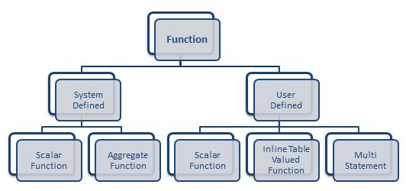
SQL Functions

Slide 18
SQL Functions
Creating user defined functions
The User defined functions contains the following components.
1) The functional name with the optional schema name
2) The input parameter and the data type
3) The several options applicable to the input parameter
4) The return parameter type and the optional name
5) The options applicable for the return parameter
6) One or more SQL statements defined by the user
The CREATE FUCNTION is used for creating the user defined function

Slide 19
SQL Functions
Functions can be Scalar or Table-valued
Basically Scalar returns one value and Table-valued functions (TVF) returns...well a table of results and this are usually found in the FROM clause of a statement.
Functions can be Deterministic or Nondeterministic
Demerministic = This means they return the same value any time they are called with a specific set of input values.
i.e SELECT LEN('TEST) will always returns 4
Nondeterministic = different results every time
i.e SELECT GETDATE()

Slide 20
SQL Functions
Scalar functions accept list of parameters as input and returns a single data value of the data type specified in the RETURNS clause. A scalar function can return any data type except text, image, ntext, and timestamp. Some of the scalar functions do not need any arguments.
The function is defined between the BEGIN…END block of the function body.
Consider the example for calculating the salary of employees. The function takes the rate as input and returns the salary of the employee.

Slide 21
SQL Functions
A table valued function returns the variable of the table data type derived from the SELECT statement. The table valued function returns the output as a table data type. The table data type is a special data type used for the set of rows. Table valued functions are of the following types.
1) Inline table valued functions
2) Multistatement table valued functions
Inline table values functions
An inline table valued functions returns a variable of a table data type from the result set of a SELECT statements. The inline function does not contain a function body with in the BEGIN and END statements.

Slide 22
SQL Functions
Multistatement table values functions
A multistatement table valued functions uses the multiple statements to build the table that is returned to the calling statements. The function is enclosed in the BEGIN … END block. The statements are used to insert rows in the temporary table. The table is returned in the result set and is created based on the specification mentioned statement.

Slide 23
SQL Stored Procedures
A stored procedure is an already written SQL statement that is saved in the database. If you find yourself using the same query over and over again, it would make sense to put it into a stored procedure. When you put this SQL statement in a stored procedure, you can then run the stored procedure from the database’s command environment using the exec command.
Like a function, a stored procedure can be used to perform a calculation. As an alternative to a regular function, a stored procedure can produce a query. Like a view, a stored procedure can be used to create and store a query. As an alternative to a view, a stored procedure can be used to create and store many queries from tables that have nothing in common. A stored procedure solves many more problems than that (this discussion doesn't suggest in any way that a stored procedure is better or worse than either a function or a view; functions, views, and stored procedures are used to solve different types of problems).
exec usp_displayallusers --- (select user_name from all_users)

Slide 24
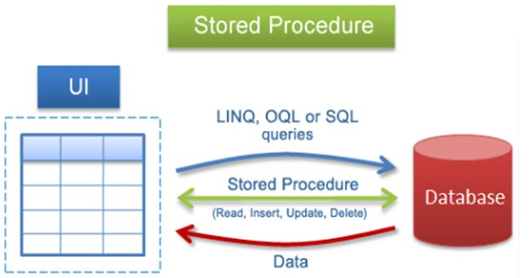
SQL Stored Procedures

Slide 25
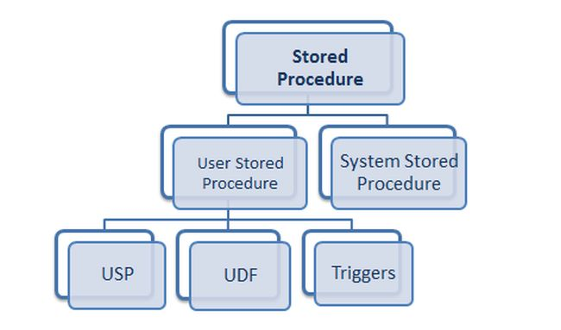
SQL Stored Procedures

Slide 26
Summary
Stored procedures are a very powerful database component.
System-stored procedures are useful for database administration and maintenance.
User-defined stored procedures are useful for whatever you have designed them for.
They have advantages over views and queries in that they are precompiled, and after their first execution, their execution plan is stored in the procedure cache that resides in random access memory (RAM).
Another benefit of stored procedures is that you can assign permission to a user to run a stored procedure even if that user does not have permissions on the underlying tables.
You can view some interesting stored procedure code by running the sp_helptext system-stored procedure on the stored procedures in the master database (for example, sp_helptext sp_helpdevice).

